Slide 1

Industrial IoT and Digital Twins of Cyber Physical Systems PROJECT Submission

Slide 2
TABLE OF CONTENTS
01
02
PROJECT BRIEFING
Physical systems
03
04
Cyber system
Integration and Data flow

Slide 3
INTRODUCTION
With our objective of building a physical system and it cyber counter part and linking the two in a harmonious manner. Implementing some of the concepts outlined in our study .

Slide 4
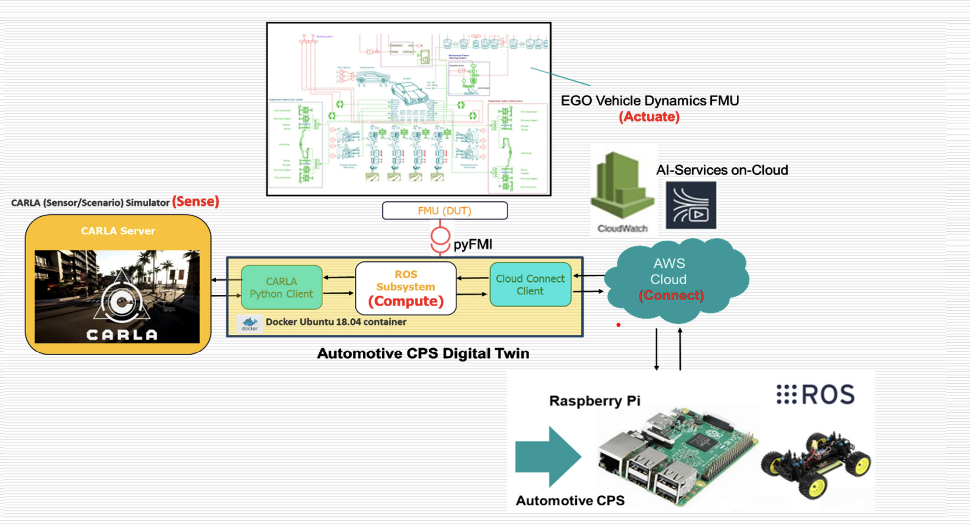
PROJECT BRIEFING
Do you know what could help you make your point clear?
Lists like this one:
They’re simple
You can organize your ideas clearly
You’ll never forget to buy milk!
And the most important thing: the audience won’t miss the point of your presentation

Slide 5
Physical System
Raspberry Pi
Physical car
Arduino
Controls the outflow of data into the cloud and interfaces with cyber modules
RC car with Four motors and an ultrasonic sensor
Controls the RC car , send the status report and sensor data

Slide 6



Cyber System
Raspberry Pi
AWS IOT Cloud
Robotic control system
Sends data into the AWS cloud using the MQTT protocol
Provides storage and mid way point for the data between the physical and the cyber
Carla
Gets the data from the cloud and controls the Carla model
The Car simulation system that is run by ROS and provides a cyber simulation for it

Slide 7
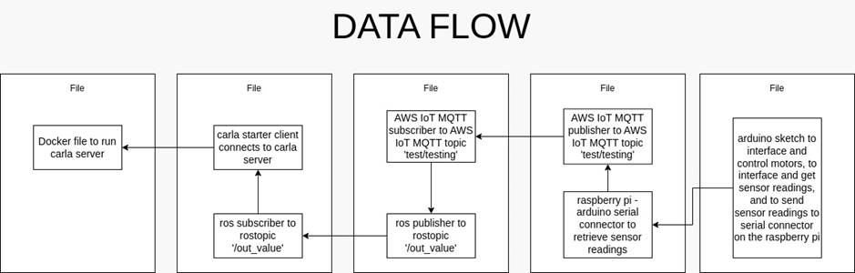
DATA FLOW

Slide 8
See Results

Slide 9
THANKS
Please keep this slide for attribution

